Slide 1
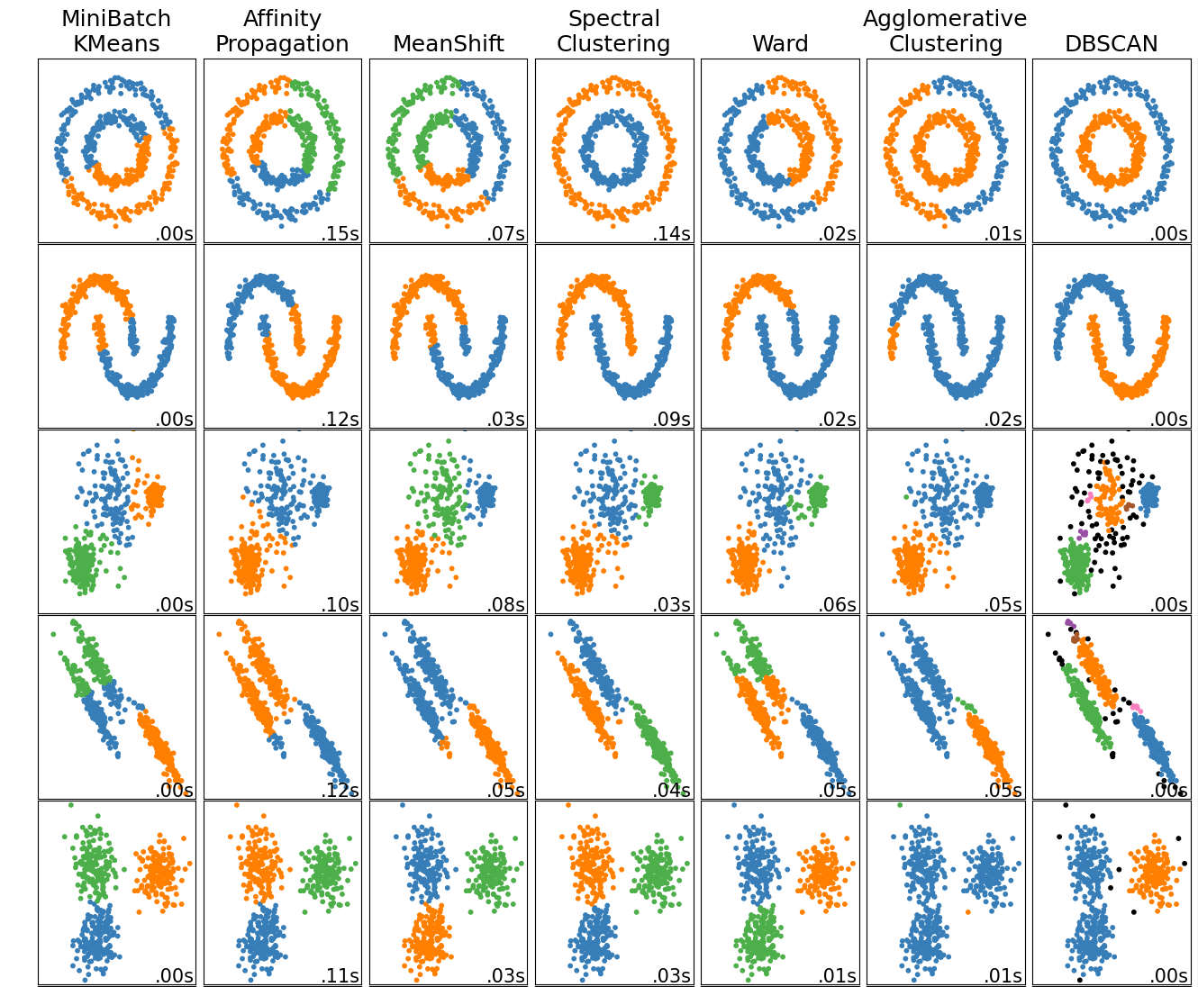
Unsupervised Learning Part 2: Hierarchical Clustering

Slide 2
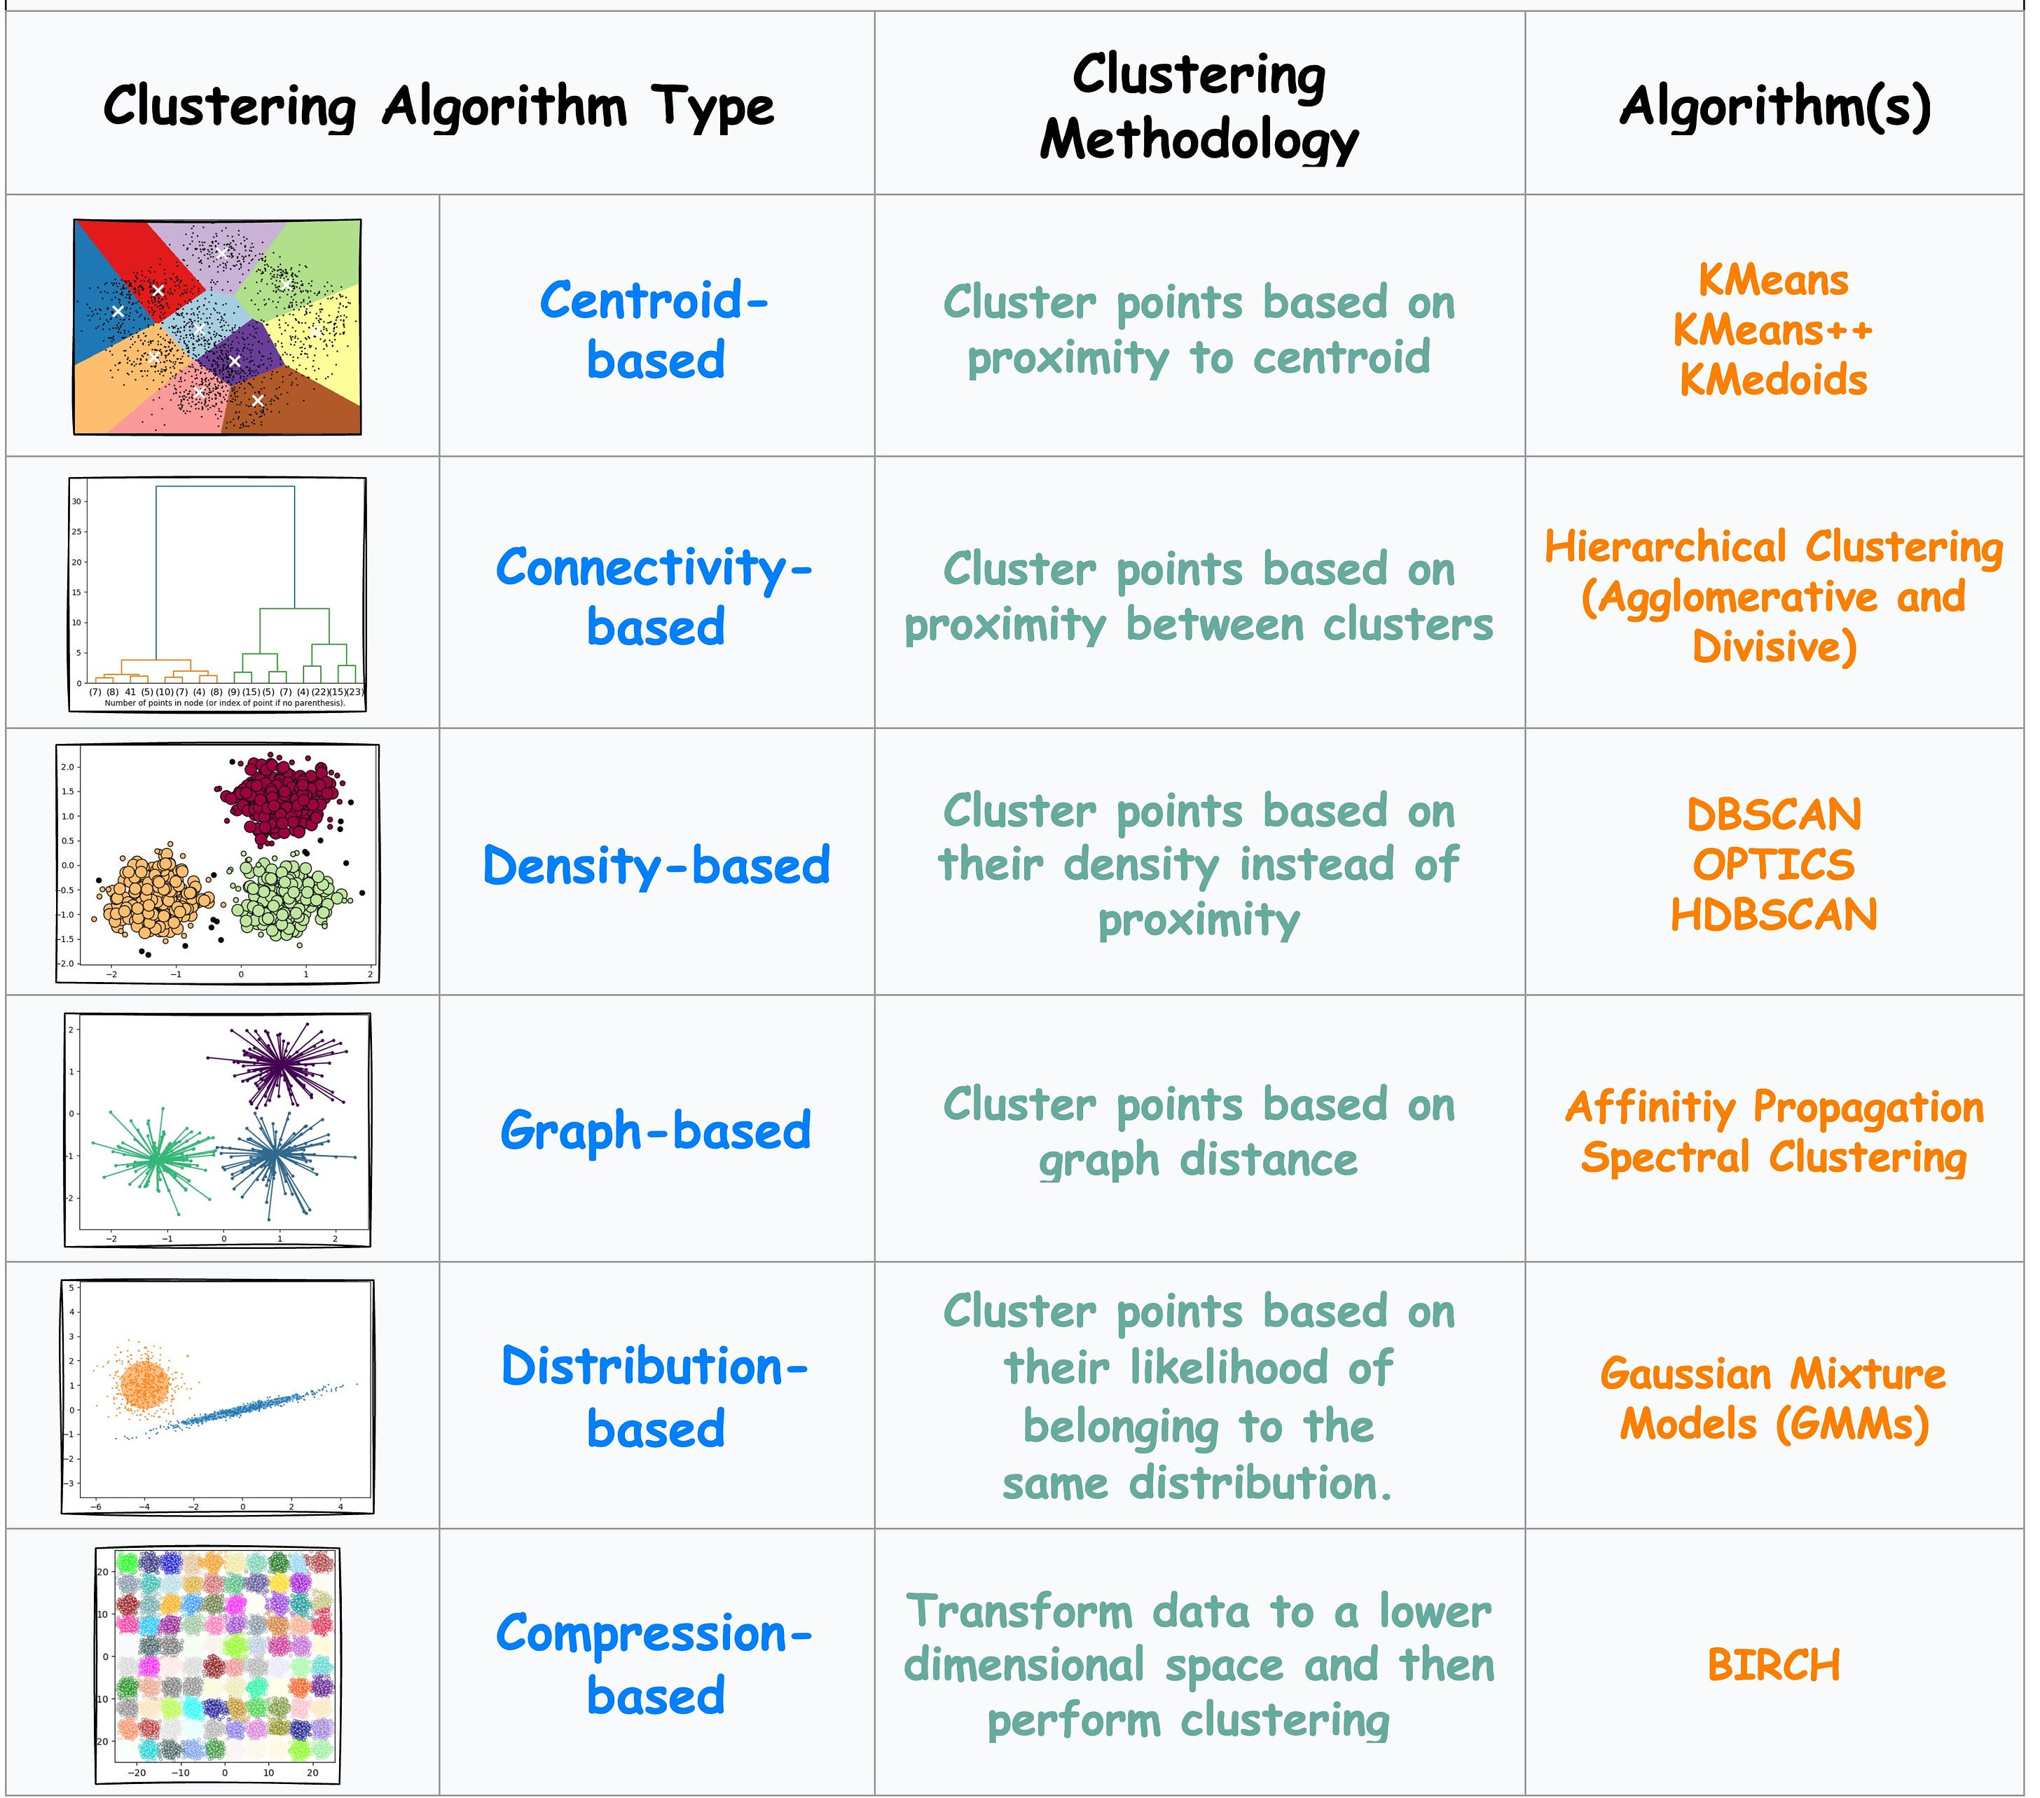

Outline
Hierarchical Clustering
Agglomerative
Divisive
Density Based Clustering
DBSCAN

Slide 3
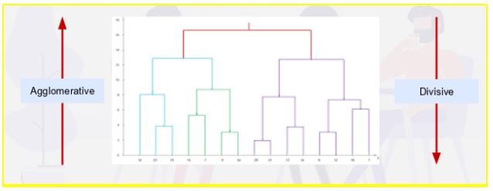
Hierarchical Clustering
There are two types of Hierarchical clustering techniques:
Agglomerative
Divisive
Agglomerative clustering is a bottom-up approach. Start with every point as a cluster and combine points till only a single cluster. (most common)
Divisive clustering is a top-down approach. Start with one large cluster and divide it into two, three, four, or more clusters.

Slide 4
Comparison between Agglomerative and Divisive Clustering
Parameters | Agglomerative Clustering | Divisive Clustering
Category | Bottom-up approach | Top-down approach
Approach | Each data point starts in its own cluster, and the algorithm recursively merges the closest pairs of clusters until a single cluster containing all the data points is obtained. | All data points start in a single cluster, and the algorithm recursively splits the cluster into smaller sub-clusters until each data point is in its own cluster.
Complexity Level | Agglomerative clustering is generally more computationally expensive, especially for large datasets, as this approach requires the calculation of all pairwise distances between data points. O(n³)--O(n²log(n)). But new versions come close to linear O(n) for certain use cases. | Comparatively less expensive as divisive clustering only requires the calculation of distances between sub-clusters, which can reduce the computational burden. O(n²)
Outliers | Agglomerative clustering can handle outliers better than divisive clustering since outliers can be absorbed into larger clusters | Divisive clustering may create sub-clusters around outliers, leading to suboptimal clustering results.
Interpretability | Agglomerative clustering tends to produce more interpretable results since the dendrogram shows the merging process of the clusters, and the user can choose the number of clusters based on the desired level of granularity. | Divisive clustering can be more difficult to interpret since the dendrogram shows the splitting process of the clusters, and the user must choose a stopping criterion to determine the number of clusters.
Implementation | Scikit-learn provides multiple linkage methods for agglomerative clustering, such as “single,” “complete,” “average,” and “ward.” | Divisive clustering is not implemented in Scikit-learn.
Example | Agglomerative Clustering is used in Image segmentation, Customer segmentation, Social network analysis, Document clustering, genomics, etc. | Divisive Clustering is used in Market segmentation, Anomaly detection, Biological classification, Natural language processing, etc.

Slide 5
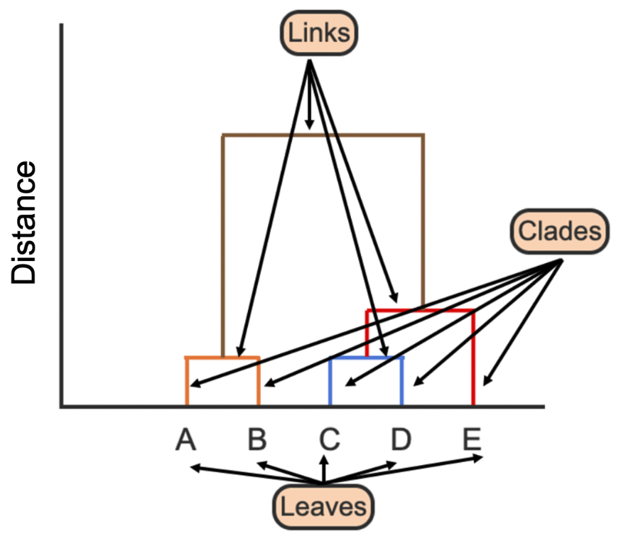
Dendrogram
The output of a hierarchical clustering algorithm is a dendrogram. A dendrogram is a tree that shows the order in which clusters are grouped together and the distances between clusters.
Parts of a dendrogram are listed below:
A clade is a branch of a dendrogram or a vertical line.
A link is a horizontal line that connects two clades, whose height gives the distance between clusters.
A leaf is the terminal end of each clade in a dendrogram, which represents a single instance.
Notes:
Clade: height of branch points indicates how similar or different clusters are. Higher branches – greater dissimilarity.

Slide 6
Agglomerative Clustering Intuition

Slide 7
Agglomerative Clustering Algorithm
Steps:
Compute the proximity (distance) matrix between each point or cluster
Initialize: Let each data point be a cluster
Repeat
Merge the two closest clusters
Update the proximity matrix
Until only a single cluster remains
The key operation is the computation of the proximity (distance) of two clusters.
To do this, we define different approaches to measuring inter-cluster distance. These approaches are called “Linkages.”

Slide 8
Proximity Matrix
Clusters | x₁ | x₂ | x₃ | … | x_{n}
x₁ | 0 | d(x_{1,} x₂) | d(x_{1,} x₃) | … | d(x_{1,} x_{n})
x₂ | d(x_{2,} x₁) | 0 | d(x_{2,} x₃) | … | d(x_{2,} x_{n})
x₃ | d(x_{3,} x₁) | d(x_{3,} x₁) | 0 | … | d(x_{3,} x_{n})
… | … | … | … | 0 | …
x_{n} | d(x_{n,} x₁) | d(x_{n,} x₁) | d(x_{n,} x₁) | … | 0
Calculate all distances between clusters and/or points
Symmetric Matrix
Distances to self = 0
Use Euclidean, Manhattan, or other
Update the Proximity Matrix after each iteration
Merge clusters using Linkage Function

Slide 9
Linkage Function Intuition

Slide 10
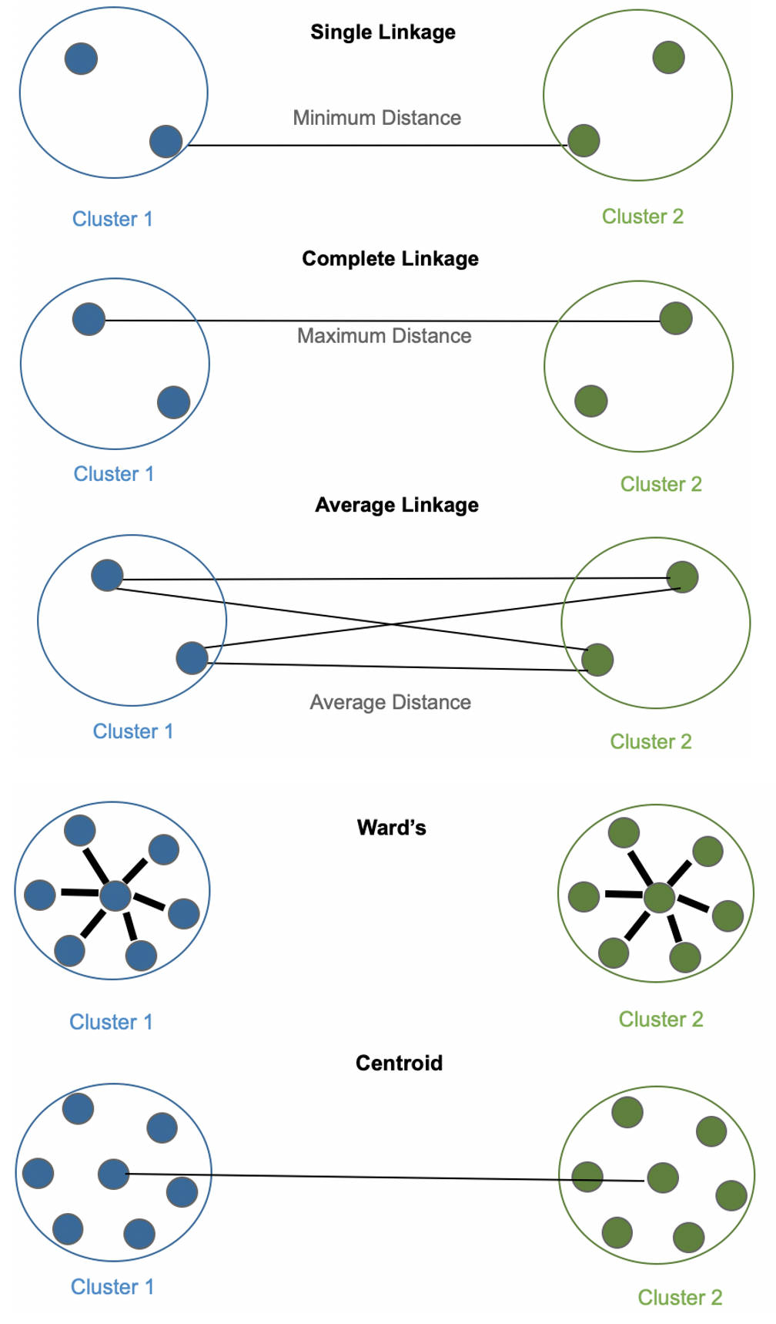
Linkage Methods
Linkage methods are crucial as they determine how clusters are formed. Here are some standard linkage methods used in hierarchical clustering:
Single Linkage: (aka Nearest Neighbor) This method joins clusters based on the minimum distance between their data points. It tends to create long, "stringy" clusters and is sensitive to outliers.
Complete Linkage: Connects clusters by their maximum pairwise distance, resulting in compact, spherical clusters. However, it can be sensitive to outliers as well.
Average Linkage: This method calculates the average distance between data points in two clusters. It produces balanced clusters and is less sensitive to outliers than single or complete linkage.
Ward's Linkage: Ward's method minimizes the increase in variance within the clusters when merging them. It often produces equally sized clusters and is suitable for minimizing the variance in the data.
Centroid Linkage: Combines clusters with minimum distance between centroids (Mean, Median, Medoid, Mode)
These linkage methods play a crucial role in shaping the hierarchical clustering output, and the choice depends on the specific characteristics of your data and your analysis goals.
Notes:
.

Slide 11
Linkage Method Examples
A
B
Single Linkage
Complete Linkage

Slide 12
Linkage Method Examples
A
B
Average Linkage

Slide 13
Linkage Method Examples
A
B
Centroid Linkage

Slide 14
Linkage Method Examples
A
B
₊
Ward’s Linkage
Compute intra-cluster Sum-of-Squared Errors (ESS) for each cluster individually
Combine clusters if combined ESS is less than sum of each individual cluster ESS
Objective is to minimize the ESS of joint clusters
Notes:
Ward’s method says that the distance between two clusters, A and B, is how much the sum of squares will increase when we merge them: ∆(A, B) = X i∈A∪B k~xi − ~mA∪Bk 2 − X i∈A k~xi − ~mAk 2 − X i∈B k~xi − ~mBk 2 (2) = nAnB nA + nB k~mA − ~mBk 2 (3) where ~mj is the center of cluster j, and nj is the number of points in it. ∆ is called the merging cost of combining the clusters A and B. With hierarchical clustering, the sum of squares starts out at zero (because every point is in its own cluster) and then grows as we merge clusters. Ward’s method keeps this growth as small as possible. This is nice if you believe that the sum of squares should be small. Notice that the number of points shows up in ∆, as well as their geometric separation. Given two pairs of clusters whose centers are equally far apart, Ward’s method will prefer to merge the smaller ones. Ward’s method is both greedy, and constrained by previous choices as to which clusters to form. This means its sum-of-squares for a given number k of clusters is usually larger than the minimum for that k, and even larger than what k-means will achieve. If this is bothersome for your application, one common trick is use hierarchical clustering to pick k (see below), and then run k-means starting from the clusters found by Ward’s method to reduce the sum of squares from a good starting point.

Slide 15
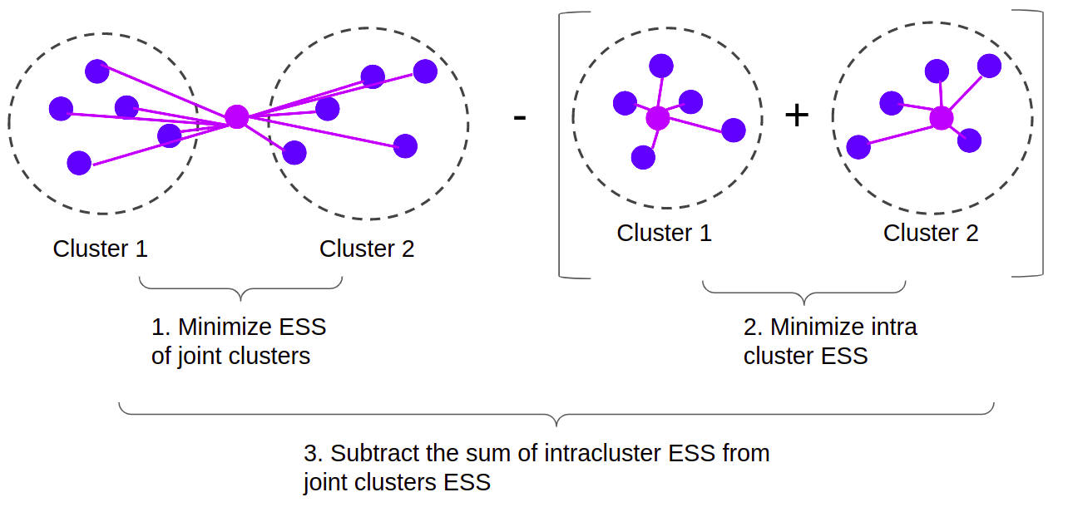
Ward Linkage
Notes:
https://stackabuse.com/hierarchical-clustering-with-python-and-scikit-learn/
Also known as MISSQ (Minimal Increase of Sum-of-Squares). It specifies the distance between two clusters, computes the sum of squares error (ESS), and successively chooses the next clusters based on the smaller ESS. Ward's Method seeks to minimize the increase of ESS at each step. Therefore, minimizing error.

Slide 16
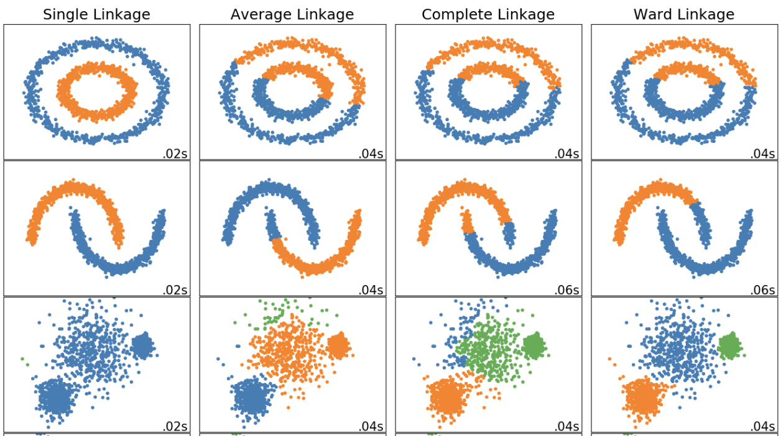
Impact of Different Linkage Methods
Notes:
Single linkage works well for for two data sets but fails for the third.
Ward linkage is the only one that woks well on the third data set.

Slide 17
Hierarchical Agglomerative Clustering Example
Let’s say a clothing store has collected the ages of 9 of its customers, labeled C1-C9, and the amount each spent at the store last month.
We start by making every single data point a cluster. This forms 9 clusters:
Take the two closest clusters and make them one cluster. Since C2 and C3 are closest, they form a cluster.
Take the next two closest clusters and make them one cluster. Since C4 and C5 are closest, they form a cluster.
C6
C6
C5
C6
C5
C6
C5
C5
C4
C4
C4
C4
Spend
Spend
Spend
Spend
C9
C9
C1
C9
C3
C1
C9
C3
C1
C3
C1
C3
C7
C7
C7
C7
C8
C8
C8
C8
C2
C2
C2
C2
Age
Age
Age
Age
Distance
Dendrogram
Distance
Distance
32
32
45
Clusters
Clusters
Clusters

Slide 18
HAC Example Continued
Based on Single Linkage, merge C45 with C6.
Based on Single Linkage, merge C23 with C1
Based on distance, merge C7 and C8
Merge C78 with C9
C5
C6
C5
C6
C5
C6
C5
C6
C4
C4
C4
C4
Spend
Spend
Spend
Spend
C3
C1
C9
C3
C1
C9
C3
C1
C9
C3
C1
C9
C7
C7
C7
C7
C8
C8
C8
C8
C2
C2
C2
C2
Age
Age
Age
Age
789
Distance
Distance
Distance
Distance
78
78
456
123
456
123
456
123
456
23
45
23
45
23
45
23
45
Clusters
Clusters
Clusters
Clusters

Slide 19
HAC Example End
Starting from previous page
Using Single Linkage, merge C456 with C789
Finally, merge C123 with C456789 to form one cluster.
C5
C6
C5
C6
C5
C6
C4
C4
C4
Spend
Spend
Spend
C3
C1
C9
C3
C1
C9
C3
C1
C9
C7
C7
C7
C8
C8
C8
C2
C2
C2
Age
Age
Age
456789
456789
789
789
789
Distance
Distance
Distance
78
78
78
123
456
123
456
123
456
23
45
23
45
23
45
Clusters
Clusters
Clusters

Slide 20
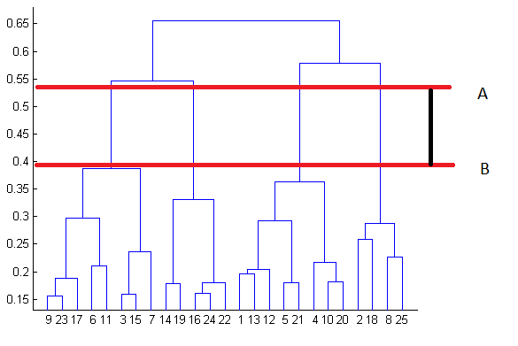
Using Dendrograms to find Optimal Cluster Number
We can use a dendrogram to visualize the history of groupings and figure out the optimal number of clusters.
Determine the largest vertical distance that doesn’t intersect any of the other clusters
Draw a horizontal line across the diagram
The optimal number of clusters is equal to the number of vertical lines going through the horizontal line

Slide 21

Agglomerative Clustering Python Example

Slide 22
References
https://towardsdatascience.com/the-5-clustering-algorithms-data-scientists-need-to-know-a36d136ef68
https://www.geeksforgeeks.org/ml-k-medoids-clustering-with-example/
https://www.analyticsvidhya.com/blog/2021/06/kmodes-clustering-algorithm-for-categorical-data/#h-what-is-kmodes
https://towardsdatascience.com/the-k-prototype-as-clustering-algorithm-for-mixed-data-type-categorical-and-numerical-fe7c50538ebb
http://scikit-learn.org/stable/modules/clustering.html
https://citeseerx.ist.psu.edu/viewdoc/download?doi=10.1.1.15.4028&rep=rep1&type=pdf
https://github.com/nicodv/kmodes/blob/master/kmodes/kprototypes.py
https://dashee87.github.io/data%20science/general/Clustering-with-Scikit-with-GIFs/
https://www.geeksforgeeks.org/difference-between-agglomerative-clustering-and-divisive-clustering/
https://stackabuse.com/dbscan-with-scikit-learn-in-python/

